Slide 1
Chapter 13: Memory Improvement and Learning Efficiency

Slide 2
Introduction (1 of x)
Learning and remembering are ubiquitous human activities
  Occurs as early as prenatal development
Formal education vs. informal learning.
Guide to memory improvement.
The role of hard work.
Notes:
Satisfies Learning Objective 1: Learn the four principles of memory improvement and learning efficiency.
Activities: Learning and remembering:
Ubiquitous human activities.
Learning occurs in the developing fetus.
Functioning in today’s world requires constant retraining.
Formal education and informal learning:
Across the world, most children engage in some form of formal education.
The United States spends billions of dollars, annually, to promote learning and remembering, indicating that efficient learning is financially expedient and vital to national security.
Informal learning goes on in our everyday lives, in businesses, in homes, and on our computers.
Guide to memory improvement:
Specific instruction in how to maximize your learning and memory abilities is usually lacking.
This chapter is intended as a guide to memory improvement and learning efficiency.
The role of hard work: Memory improvement requires work and intelligent application.

Slide 3
Introduction (2 of x)
Learning tasks usually omit specific instructions on how to maximize learning/memory
Work + application
Notes:
Satisfies Learning Objective 1: Learn the four principles of memory improvement and learning efficiency.
Guide to memory improvement:
Specific instruction in how to maximize your learning and memory abilities is usually lacking.
This chapter is intended as a guide to memory improvement and learning efficiency.
The role of hard work: Memory improvement requires work and intelligent application.

Slide 4
Introduction (3 of x)
Process of learning: Memory is enhanced when you focus on what the information means
Retrieval practice: Generate and practice the items you need to remember rather than reading/restudying
Metamemory: Monitoring vs. control
Distributed learning or practice: Spacing study over time vs. cramming
Notes:
Satisfies Learning Objective 1: Learn the four principles of memory improvement and learning efficiency.
Process for meaning: As you learn new material, focus on what it means.
Retrieval practice:
Generate and practice the items you need to remember from memory rather than simply read or restudy them.
Retrieval practice means self-testing.
Metamemory: Our knowledge and awareness of our own memory processes.
Distributed learning or practice: Spacing one’s study over time can lead to faster acquisition of information.

Slide 5
Process for Meaning (1 of 3)
Bransford and Johnson (1972): Two groups of participants read a story. One group got clues, one group got clues + title
  Title group had better memory, because they could process for meaning more easily
Real-life applications: Facts vs. Concepts in higher education
Subjective organization: Students remember more when they are forced to organize the material themselves
Notes:
Satisfies Learning Objective 2: Demonstrate that you can apply the four principles to your own learning.
Study by Bransford and Johnson:
Two groups of participants were asked to read a story, with one of them provided with few clues, while the other knew also knew the title, “Washing Clothes.”
This second group remembered more details from the story than those who did not have the title, because they were better able to process for meaning.
The title provided meaning and therefore structure to the otherwise confusing passage.
Real-life applications:
In a college course, facts are usually less crucial than concepts.
Meaning is far more a significant aspect of our world than sensory characteristics.
Subjective organization:
In studying, you may want to reorganize the information given to you and make up your own organization.
Research indicates how students remember more when they are forced to organize the material themselves.
This was experimentally demonstrated by Mannes and Kintsch.

Slide 6
Process for Meaning (2 of 3)
Technical Mnemonics: Ready made methods of learning information
Acronym: First letters are formed into an easily remembered word
Acrostic: First letter forms a sentence with an easily remembered visual or auditory connotation
Notes:
Satisfies Learning Objective 2: Demonstrate that you can apply the four principles to your own learning.
Technical mnemonics: Ready-made methods of learning information, such as acronyms or acrostics.
Acronym: A mnemonic device in which the first letters of each word in a list are formed into an easily remembered word.
Acrostic: A mnemonic in which the first letter of each item in the list is used to form a sentence with an easily remembered visual image or auditory connection that makes the sentence memorable.

Slide 7
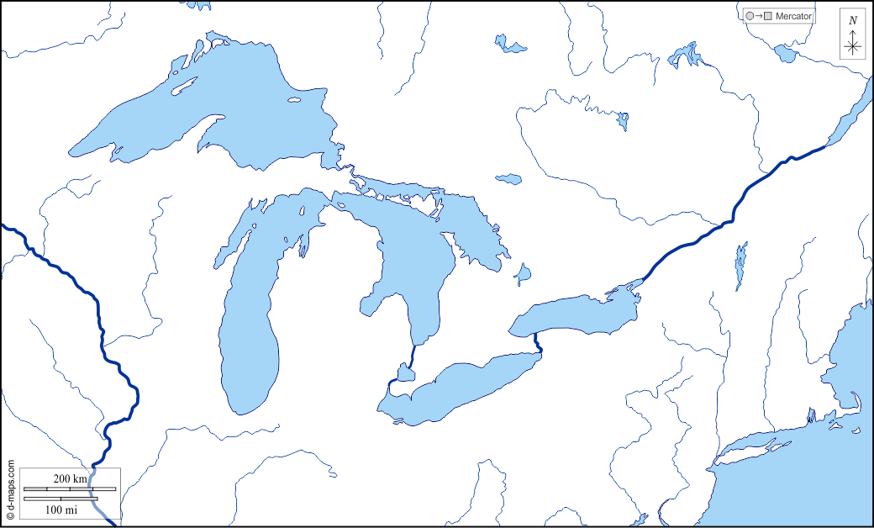
Notes:
HOMES vs Lisa Likes Licking Lettuce Lightly

Slide 8
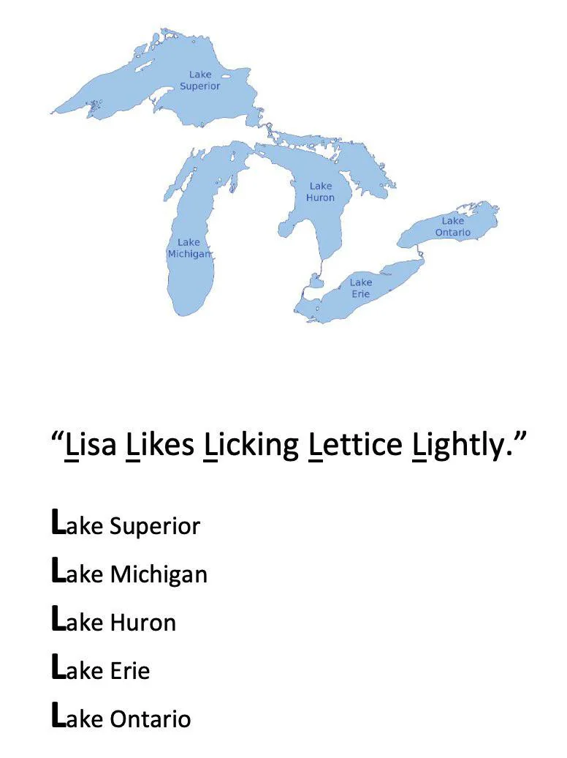
Notes:
HOMES vs Lisa Likes Licking Lettuce Lightly

Slide 9
Process for Meaning (3 of 3)
Avoid Distraction to Enhance Meaning and Retention
Divided attention prevents meaning processing
Smith et al. (2011): Higher recognition testing for students who were not allowed to use phones at study vs. those who texted
Otgaar et al. (2012): Divided attention led to lowered correct recall and increased false recall
Multitasking is linked to problems with memory efficiency
  Driven by decreased working memory
Notes:
Satisfies Learning Objective 2: Demonstrate that you can apply the four principles to your own learning.
Divided attention:
Divided attention prevents processing for meaning, which lowers one’s memory efficiency.
Data suggests that an easy way to improve learning is to leave the electronics behind when while studying.
Examination by Smith et al.:
The researchers examined the effects of texting while studying by dividing participants into two groups, one of which was not allowed to use cell phones and a second group that was encouraged to text while studying.
The results revealed higher scores in recognition performance in the non-distracted group.
Otgaar et al., in a separate study, also found that divided attention both lowered correct recall and increased false recall.
Evidence from other studies:
Brewer et al. found that participants with divided attention showed an impairment on prospective memory tests.
Parker et al. demonstrated how divided attention interfered with category-cued recall.
Chronic distraction on memory:
People who multitask are at risk of creating long-lasting problems with memory efficiency.
This theory has been demonstrated in a study by Uncapher et al. who found that chronic multitaskers performed worse on working-memory tests and long-term memory tests even when they were not multitasking.

Slide 10
Engage in Retrieval Practice (1 of 4)
Testing oneself: Self-testing and classroom testing both lead to strong memory traces/better long-term memory
Testing effect: Long-term memory is better when we test ourselves vs. restudying items
  The act of retrieving creates stronger associations between cues and targets
Notes:
Satisfies Learning Objective 2: Demonstrate that you can apply the four principles to your own learning.
Testing oneself: Self-testing, classroom testing, and other forms of testing lead to strong memory traces and more long-term retention.
Testing effect:
Memory is better when we test ourselves than when we simply reread an item.
Research shows that a trial of testing oneself is superior to a trial of restudy.
The act of retrieving creates stronger associations between cues and targets.
Landmark study by Roediger and Karpicke:
They investigated the advantages of retrieval practice by asking participants to read short prose passages concerning scientific information.
One group of participants simply restudied the items, while a second group read the same passage but then was asked to recall information about the story on three practice tests.
The testing group outperformed the restudy group.
Self-initiated or provided:
Retrieval practice can either be self-initiated or provided to students by instructors.
This theory is supported by findings of studies by Campbell and Mayer, and Trumbo et al.

Slide 11
Engage in Retrieval Practice (2 of 4)
Roediger and Karpicke (2006): Directly investigated the testing effect
  Particpants read short passages and either:
    Restudied the information
    Or completed three practice tests
  Memory for each group was tested after 5 minutes, 2 days, and 1 week.
Notes:
Landmark study by Roediger and Karpicke:
They investigated the advantages of retrieval practice by asking participants to read short prose passages concerning scientific information.
One group of participants simply restudied the items, while a second group read the same passage but then was asked to recall information about the story on three practice tests.
The testing group outperformed the restudy group.
Self-initiated or provided:
Retrieval practice can either be self-initiated or provided to students by instructors.
This theory is supported by findings of studies by Campbell and Mayer, and Trumbo et al.

Slide 12
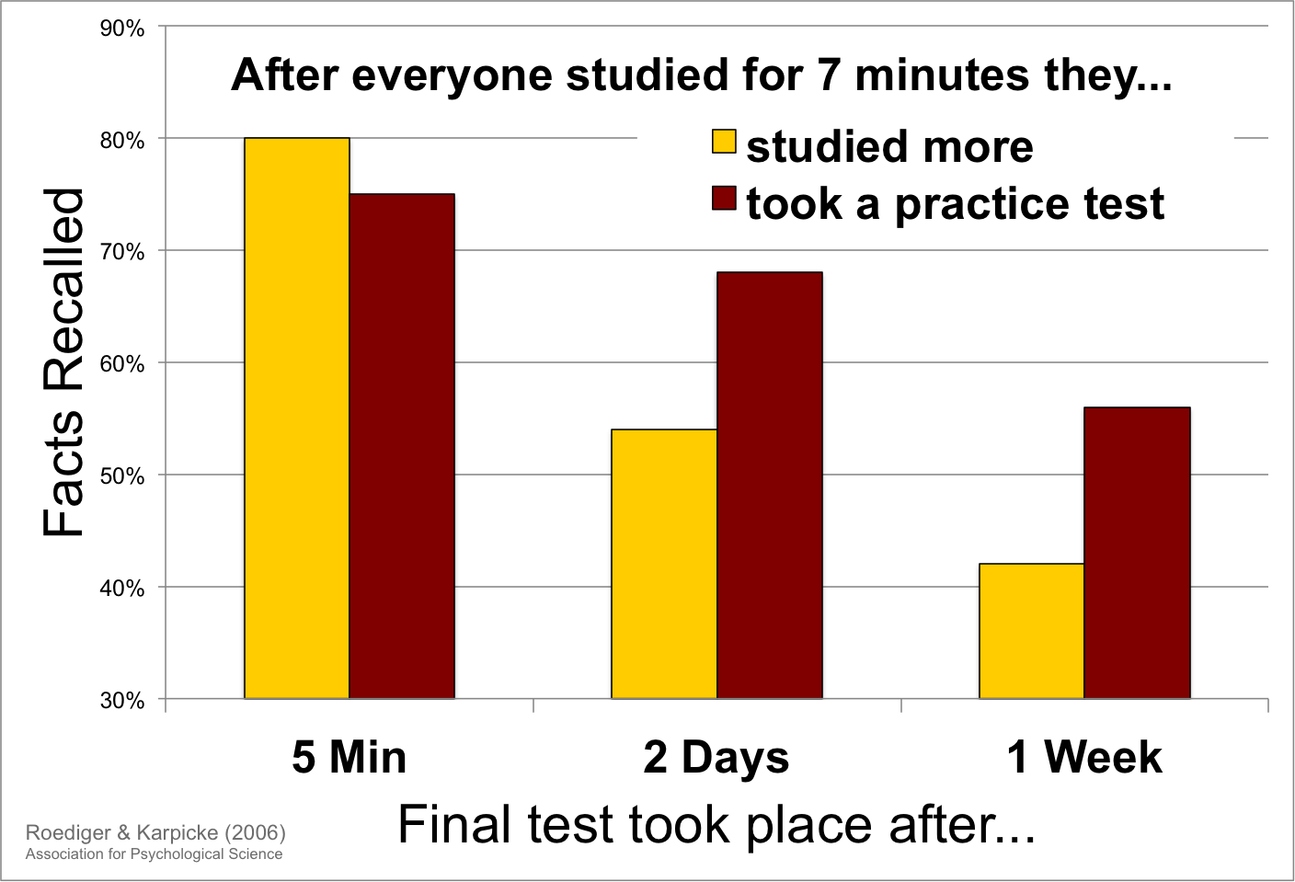

Slide 13
Engage in Retrieval Practice (3 of 4)
Even generating a wrong on answer on a test leads to better retention, as long as there is feedback
Generation effect (Slamecka & Graff, 1978): Memory is better when we generate associations ourselves vs. just reading
Notes:
Satisfies Learning Objective 2: Demonstrate that you can apply the four principles to your own learning.
Effects of retrieval practice:
Even generating a wrong answer leads to better retention of the correct answer, if there is feedback.
This has been proven to be true in a study by Huesler and Metcalfe.
Metcalfe and Finn (2011) even showed that high-confidence wrong answers, once corrected, lead to good recall of the actual target.
Testing effects are not affected by distractions, as demonstrated by Buchin and Mulligan.
Huge advantage in learning: Bjork et al. suggest that even students who self-test to determine their level of preparation are often unaware of this effect.
Generation effect: Memory is better when we generate associations ourselves than when we simply read them.

Slide 14
Engage in Retrieval Practice (4 of 4)
Retrieval Cues and Encoding Variability
Good retrieval cues: Bits of information that help us recall information
Encoding variability: Studying an item under multiple conditions leads to better memory vs. uniform conditions
Encoding specificity: Memory is better when conditions at retrieval match encoding conditions
Highly effective when combined with retrieval practice!
Notes:
Satisfies Learning Objective 2: Demonstrate that you can apply the four principles to your own learning.
Good retrieval cues:
A technique that can be used to improve memory efficiency.
Cues are bits of information provided by either the external environment or your own imagination.
Cues are triggers that help us recall the information that is associated with them.
Encoding variability: The principle that if you study an item of information under several mental and physical conditions, you will be more likely to remember it than if you had studied for the same amount of time or number of trials but under uniform conditions.
Encoding specificity: Retrieval of information from memory will be maximized when the conditions at retrieval match the conditions at encoding.
Advantages:
Encoding variability can help to improve the efficiency of one’s learning.
It can also be combined with retrieval practice for the same purpose.
Both encoding variability and retrieval practice require active learning on the part of the student or other learner.

Slide 15
Desirable Difficulties
Link between memory and difficulty of encoding
  Harder encoding tasks lead to improved memory (Bjork & Bjork, 2011).
  Example: Generation (Mouse – C_E_S_) is more difficult than reading (Mouse – CHEESE)
Notes:
Satisfies Learning Objective 2: Demonstrate that you can apply the four principles to your own learning.
Good retrieval cues:
A technique that can be used to improve memory efficiency.
Cues are bits of information provided by either the external environment or your own imagination.
Cues are triggers that help us recall the information that is associated with them.
Encoding variability: The principle that if you study an item of information under several mental and physical conditions, you will be more likely to remember it than if you had studied for the same amount of time or number of trials but under uniform conditions.
Encoding specificity: Retrieval of information from memory will be maximized when the conditions at retrieval match the conditions at encoding.
Advantages:
Encoding variability can help to improve the efficiency of one’s learning.
It can also be combined with retrieval practice for the same purpose.
Both encoding variability and retrieval practice require active learning on the part of the student or other learner.

Slide 16
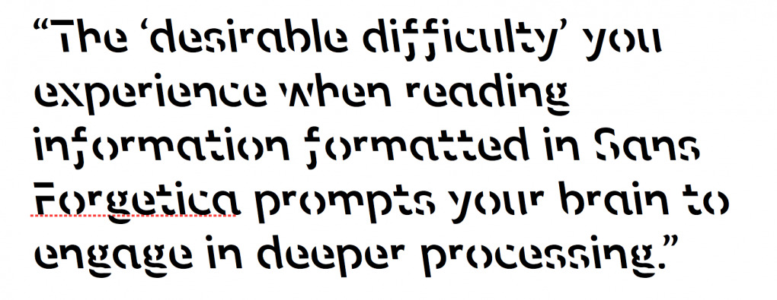
Sans Forgetica (1 of 3)
A special font designed using principles of desirable difficulties to enhance memory
Notes:
Satisfies Learning Objective 2: Demonstrate that you can apply the four principles to your own learning.
Good retrieval cues:
A technique that can be used to improve memory efficiency.
Cues are bits of information provided by either the external environment or your own imagination.
Cues are triggers that help us recall the information that is associated with them.
Encoding variability: The principle that if you study an item of information under several mental and physical conditions, you will be more likely to remember it than if you had studied for the same amount of time or number of trials but under uniform conditions.
Encoding specificity: Retrieval of information from memory will be maximized when the conditions at retrieval match the conditions at encoding.
Advantages:
Encoding variability can help to improve the efficiency of one’s learning.
It can also be combined with retrieval practice for the same purpose.
Both encoding variability and retrieval practice require active learning on the part of the student or other learner.

Slide 17
Sans Forgetica (2 of 3)
Research suggests little to no benefit of Sans Forgetica on Memory
  Taylor et al. (2020): No recall benefit of Sans Forgetica for unrelated word pairs
  Geller et al. (2021): No benefit on learning prose passages
  Maxwell et al. (2022): Memory of word pairs was WORSE for Sans Forgetica vs Arial
Notes:
Satisfies Learning Objective 2: Demonstrate that you can apply the four principles to your own learning.
Good retrieval cues:
A technique that can be used to improve memory efficiency.
Cues are bits of information provided by either the external environment or your own imagination.
Cues are triggers that help us recall the information that is associated with them.
Encoding variability: The principle that if you study an item of information under several mental and physical conditions, you will be more likely to remember it than if you had studied for the same amount of time or number of trials but under uniform conditions.
Encoding specificity: Retrieval of information from memory will be maximized when the conditions at retrieval match the conditions at encoding.
Advantages:
Encoding variability can help to improve the efficiency of one’s learning.
It can also be combined with retrieval practice for the same purpose.
Both encoding variability and retrieval practice require active learning on the part of the student or other learner.

Slide 18
Sans Forgetica (3 of 3)
Why so many failures???
Notes:
Satisfies Learning Objective 2: Demonstrate that you can apply the four principles to your own learning.
Good retrieval cues:
A technique that can be used to improve memory efficiency.
Cues are bits of information provided by either the external environment or your own imagination.
Cues are triggers that help us recall the information that is associated with them.
Encoding variability: The principle that if you study an item of information under several mental and physical conditions, you will be more likely to remember it than if you had studied for the same amount of time or number of trials but under uniform conditions.
Encoding specificity: Retrieval of information from memory will be maximized when the conditions at retrieval match the conditions at encoding.
Advantages:
Encoding variability can help to improve the efficiency of one’s learning.
It can also be combined with retrieval practice for the same purpose.
Both encoding variability and retrieval practice require active learning on the part of the student or other learner.

Slide 19
Use Metamemory (1 of 6)
Metamemory also plays an important role in remembering
Metamemory:
  Awareness and knowledge of our own memories
Allows us to distinguish between easy and difficult items.
Notes:
Satisfies Learning Objective 2: Demonstrate that you can apply the four principles to your own learning.
Role in memory improvement: According to research in cognitive psychology, metamemory plays an important role in ordinary learning and remembering, and in memory improvement.
Meaning of metamemory:
Our awareness and knowledge of our own memories.
These can be used to structure our learning and remembering.
Distinguish between easy and difficult items: Metamemory is good at distinguishing difficult items from easy ones.

Slide 20
Use Metamemory (2 of 6)
Judgments of Learning as Mnemonic Improvement Tools
Judgments of learning: Participants rate ability to remember information on a later memory test
Helpful for identifying which items need additional study
Act of making judgments may also improve memory?
Notes:
Satisfies Learning Objective 2: Demonstrate that you can apply the four principles to your own learning.
Judgments of learning:
Judgments during study of whether the item has been learned already.
More accurate judgments of learning can be made by using the delayed judgment of learning effect.
Judgments of learning provide feedback as to what you have learned and what you have not.
Improvements in memory:
Judgments of learning allow us to direct our time, energy, and effort toward those items for which we need the most study.
They also allow us to adaptively control our study behavior, depending on our goals and our circumstances.
Region of proximal learning:
A theory of metamemory that advances that an adaptive learning strategy is to study those items that have not yet been learned but are not too difficult, those at the leading edge of difficulty.
The theory was developed by Janet Metcalfe and her colleagues.
Screen to determine difficulty: Judgments of learning can be used as a screen to determine the difficulty of items, given that easy items require less study than difficult items.

Slide 21
Use Metamemory (3 of 6)
Judgment of Learning Reactivity: The act of making JOLs at encoding changes how information is processed
Positive reactivity: Memory Benefits
Negative reactivity: Memory Costs
Notes:
Satisfies Learning Objective 2: Demonstrate that you can apply the four principles to your own learning.
Judgments of learning:
Judgments during study of whether the item has been learned already.
More accurate judgments of learning can be made by using the delayed judgment of learning effect.
Judgments of learning provide feedback as to what you have learned and what you have not.
Improvements in memory:
Judgments of learning allow us to direct our time, energy, and effort toward those items for which we need the most study.
They also allow us to adaptively control our study behavior, depending on our goals and our circumstances.
Region of proximal learning:
A theory of metamemory that advances that an adaptive learning strategy is to study those items that have not yet been learned but are not too difficult, those at the leading edge of difficulty.
The theory was developed by Janet Metcalfe and her colleagues.
Screen to determine difficulty: Judgments of learning can be used as a screen to determine the difficulty of items, given that easy items require less study than difficult items.

Slide 22
Use Metamemory (4 of 6)
Research suggests that making JOLs can benefit memory (positive reactivity)
Soderstrom et al. (2015):
  JOLs benefitted memory for related word pairs (Cat-Dog).
  No effect on unrelated pairs (Muffin-Spoon)
Cue-Strengthening Theory: Making JOLs increases cues that are useful for memory
Notes:
Satisfies Learning Objective 2: Demonstrate that you can apply the four principles to your own learning.
Judgments of learning:
Judgments during study of whether the item has been learned already.
More accurate judgments of learning can be made by using the delayed judgment of learning effect.
Judgments of learning provide feedback as to what you have learned and what you have not.
Improvements in memory:
Judgments of learning allow us to direct our time, energy, and effort toward those items for which we need the most study.
They also allow us to adaptively control our study behavior, depending on our goals and our circumstances.
Region of proximal learning:
A theory of metamemory that advances that an adaptive learning strategy is to study those items that have not yet been learned but are not too difficult, those at the leading edge of difficulty.
The theory was developed by Janet Metcalfe and her colleagues.
Screen to determine difficulty: Judgments of learning can be used as a screen to determine the difficulty of items, given that easy items require less study than difficult items.

Slide 23
Use Metamemory (5 of 6)
Educational implications:
  No effect of JOLs on recall of key concepts from text passages (Zhao et al., 2023) or recall of general knowledge facts (Schafer & Undorf, 2023)
  Making JOLs improves recognition of previously studied items (Maxwell & Huff, 2023)
Verdict: Making JOLs may be particularly useful when preparing for multiple choice testing
Notes:
Satisfies Learning Objective 2: Demonstrate that you can apply the four principles to your own learning.
Judgments of learning:
Judgments during study of whether the item has been learned already.
More accurate judgments of learning can be made by using the delayed judgment of learning effect.
Judgments of learning provide feedback as to what you have learned and what you have not.
Improvements in memory:
Judgments of learning allow us to direct our time, energy, and effort toward those items for which we need the most study.
They also allow us to adaptively control our study behavior, depending on our goals and our circumstances.
Region of proximal learning:
A theory of metamemory that advances that an adaptive learning strategy is to study those items that have not yet been learned but are not too difficult, those at the leading edge of difficulty.
The theory was developed by Janet Metcalfe and her colleagues.
Screen to determine difficulty: Judgments of learning can be used as a screen to determine the difficulty of items, given that easy items require less study than difficult items.

Slide 24
Use Metamemory (6 of 6)
Stability Bias: Underestimating future forgetting based on what we can currently retrieve
Leads to inaccurate judgments
Underestimate forgetting! May not study enough!
Notes:
Satisfies Learning Objective 2: Demonstrate that you can apply the four principles to your own learning.
Stability bias:
Underestimating future forgetting and overestimating future remembering based on what we can retrieve now.
It is an inherent flaw in how metacognition works, leading to poor judgments and poor decision-making.
Test the theory:
Kornell and Bjork conducted 12 experiments, in which participants were asked to study some paired associates one time and other paired associates four times.
Then, they took a cued-recall test, in which recall increased across the learning trials.
Underestimate forgetting:
Stability bias means that we do not anticipate how much information we will forget over time.
Koriak et al.’s study of people’s abilities to anticipate forgetting support this statement.
Self-regulated learning: The continuous monitoring of one’s own knowledge and the continuous use of this monitoring to make informed decisions about learning and memory.

Slide 25
Distribute your Practice (1 of 3)
Distributed practice: Spacing over time
Applicable across learning domains, not just studying for exams!
  Examples?
Superior to massed practice (Cramming).
Notes:
Satisfies Learning Objective 2: Demonstrate that you can apply the four principles to your own learning.
Distributed practice: Spacing study out over time.
Applicable across learning domains: It is not limited to the domains of studying for exams or mastering a new language.
Superior to massed practice: Distributed practice is superior to massed practice in learning new skills.

Slide 26
Distribute your Practice (2 of 3)
Massed vs. Distributed Practice
Massed practice: Studying entirely in one block of time
Sometimes successful if done right before an exam
Bad for long-term learning!
Spacing effect: More learning occurs when two study trials on the same information are spread out over time
Kornell (2009): Distributed study items were recalled greater than massed study items
Notes:
Satisfies Learning Objective 2: Demonstrate that you can apply the four principles to your own learning.
Massed practice:
Studying entirely in one block of time.
It can be employed with some success right before an exam (or performance).
However, it makes us forget the long-term goal of learning.
Distributed practice promotes availability and is also more efficient.
Spacing effect: More learning occurs when two study trials on the same information are spread out over time than when they occur successively.
Supporting research:
Kornell devised a study in which participants were divided into two groups.
One group learned by massing first, the other group by distributing practice first.
The distributed items led to better cued recall than did the massed items.

Slide 27
Distribute Your Practice (3 of 3)
Distributed or mass practice?
  Most people (students) tend to use mass practice.
  Why?
Notes:
Satisfies Learning Objective 2: Demonstrate that you can apply the four principles to your own learning.
Expanded retrieval practice:
Initially spacing study of a particular item very close together to maximize learning and the advantages of retrieval practice but then spacing subsequent trials further and further apart.
It was used in a study by Landauer and Bjork to compare with standard spaced practice.
It takes advantage of both the effects of cramming as well as distributed practice.
Distributed or mass practice?
People prefer to mass their practice.
Logan et al. demonstrated how judgments of learning were not affected by massing or spacing.
Baddeley and Longman also showed that distributed practice produced better learning.
Better recall performance: Distributed practice leads to better recall performance than massed practice.

Slide 28
Visual Mnemonics (1 of 6)
Visual imagery: One of the oldest memory techniques
  Dates back to ancient Greeks (~2500 years ago)
  Method of loci: Learner uses visual imagery to associate a list of new items with a series of well-known physical locations
Notes:
Satisfies Learning Objective 3: Explain the advantages and disadvantages of visual mnemonics.
Visual imagery:
One of the oldest techniques to aid memory.
Dates back to the ancient Greeks, approximately 2500 years ago, when, in 477 BCE, the Greek poet Simonides introduced a mnemonic method still used today.
Method of loci: The learner uses visual imagery to associate a list of new items with a series of well-known physical locations.
Popular press on memory improvement: Tends to overemphasize mnemonic techniques at the expense of many of the other mnemonic “hints.”
Basic strategy:
Associate the difficult to-be-learned information with existing well-known visual memories.
This helps to form a strong association between the two, and new information is better encoded.

Slide 29
Visual Mnemonics (2 of 6)
Popular press on memory improvement tends to overemphasize mnemonic techniques
Basic strategy: Associate difficult to learn information with well known visual memories
Forms a strong association which aids encoding!
Notes:
Satisfies Learning Objective 3: Explain the advantages and disadvantages of visual mnemonics.
Visual imagery:
One of the oldest techniques to aid memory.
Dates back to the ancient Greeks, approximately 2500 years ago, when, in 477 BCE, the Greek poet Simonides introduced a mnemonic method still used today.
Method of loci: The learner uses visual imagery to associate a list of new items with a series of well-known physical locations.
Popular press on memory improvement: Tends to overemphasize mnemonic techniques at the expense of many of the other mnemonic “hints.”
Basic strategy:
Associate the difficult to-be-learned information with existing well-known visual memories.
This helps to form a strong association between the two, and new information is better encoded.

Slide 30
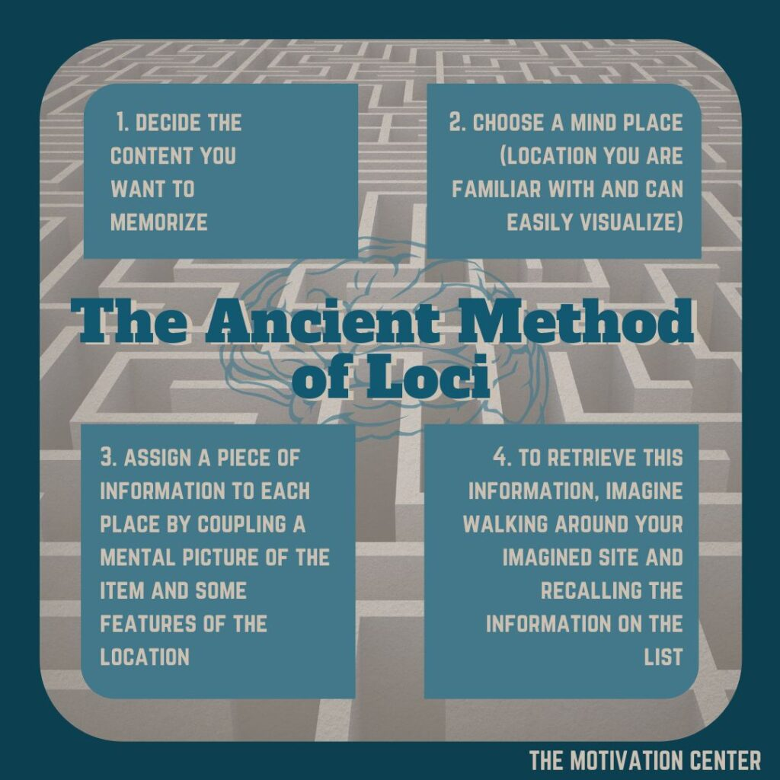

Slide 31
Visual Mnemonics (3 of 6)
Research on the Method of Loci
Groninger (1971): Students using this method outperformed those who didn’t on recalling a list of unrelated words
Findings replicated by McCabe (2008)
Especially helpful for older adults (Engvig et al., 2010)
Notes:
Satisfies Learning Objective 3: Explain the advantages and disadvantages of visual mnemonics.
Association with well-known physical locations:
To use this technique, you must be very familiar with a particular landscape.
These landmarks are designated as the memory loci and each location is then associated with new items.
Portable list:
The same landmarks can be used over and over again for different lists.
The methods also helps preserve order information.
Existing research:
Most of the studies are old, given this method is itself so old and well established.
In a study by Groninger, students who used the method of loci outperformed those who did not on recalling the unrelated words.
Groninger’s findings were replicated in a study by McCabe.
Kondo et al. (2005) showed that the method improved memory.
Engvig et al. established how the method could lead to better memory performance and structural changes in the brain in older adults.

Slide 32
Visual Mnemonics (4 of 6)
Keyword Technique: Creating an image that links two items in memory
Wang and Thomas (1995): Keyword technique is particularly helpful when learning a new language
Better for initial learning, fades with time!
Notes:
Satisfies Learning Objective 3: Explain the advantages and disadvantages of visual mnemonics.
Keyword technique:
Involves creating an image that links two items in memory.
With respect to language learning, it means creating an image that links a word in the language you know to a word in the new language.
Findings by Wang and Thomas:
The technique is particularly useful for the initial encoding of new language vocabulary.
However, earlier studies in their own lab suggested that with time, forgetting occurred just as rapidly with the keyword technique as with other methods.
The technique runs contrary to the principles of levels of processing.
They concluded that according to the levels-of-processing framework, the keyword technique may not produce good representation in long-term memory.
The researchers conducted an experiment comparing the keyword technique to standard semantic context encoding which revealed that recall was better in the semantic context condition.
It was also their belief that the keyword technique leads to good initial encoding.
However, after one or two study sessions using the keyword technique, it is advisable to switch to deeper levels of processing.

Slide 33
Visual Mnemonics (5 of 6)
Pegword Mnemonic: New words are associated with a rhyme scheme
Notes:
Satisfies Learning Objective 3: Explain the advantages and disadvantages of visual mnemonics.
Pegword technique:
A mnemonic technique that takes advantage of our natural auditory memory system as well as our visual imagery system.
New items are associated with, for example, words in a known rhyme scheme.
Empirical evidence:
The technique is helpful in memory.
It helps with initial encoding, although subsequent memorization is better done by a more meaning-driven encoding.

Slide 34
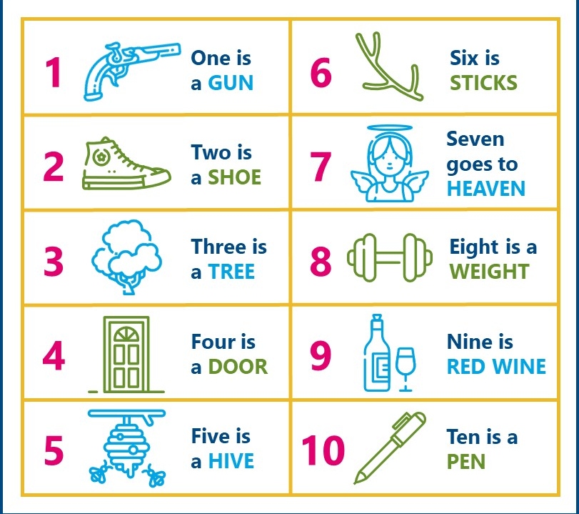

Slide 35
Visual Mnemonics (6 of 6)
Interactive Versus Bizarre Imagery
Bizarre imagery: Forming strange visual images based on to-be-learned information produces strong memory
Supporting research:
  Wollen et al. (1972): Interactive images are better than bizarre ones for good memory
  Kroll et al. (1986): Replicated this finding
Why is interactive imagery more effective for long-term remembering?
Notes:
Satisfies Learning Objective 3: Explain the advantages and disadvantages of visual mnemonics.
Bizarre imagery:
Forming strange visual images based on to-be-learned information to achieve strong memory for that information.
Essentially, a visual von Restorff effect is created.
Then, both the power of visual imagery and the power of distinctiveness to improve our memory are taken advantage of.
Supporting research:
Wollen et al. found that interactive images are better than bizarre ones at producing good memory.
Kroll et al. replicated this finding but found that people thought they had done better on the bizarre items than they actually did.

Slide 36
Myths and Methods to Avoid
No memory drug.
  No evidence that caffeine improves memory
  High levels of caffeine leads to less efficient learning
No subliminal methods to learn new information.
  Subliminal == below conscious threshold
  No evidence that playing tapes while sleeping has any positive effect on later learning/remembering
Notes:
No memory drug:
Health food stores may advertise ginkgo biloba as a memory-enhancing herbal supplement.
No scientific evidence supports this claim, although it is harmless, as established by Beck et al.
A similar theory about caffeine is also not supported by any scientific evidence.
On the contrary, people with caffeine in their bloodstreams are less efficient learners.
No subliminal methods to learn new information:
Subliminal learning means receiving information below the threshold of consciousness.
Moreover, no research supports the claim that playing tapes while sleeping will have any positive impact on later learning or remembering.

Slide 37
Mnemonists (1 of 2)
Individuals with extraordinary memory
  Occurs through innate ability + practice
Notes:
Satisfies Learning Objective 4: Interpret what there is to understand about human memory processes from mnemonists or people with extraordinary memory abilities.
Mnemonists:
People with extraordinary memory.
One becomes a mnemonist through a combination of innate ability and practice.
Inner ability and practice: Some people develop extraordinary memory through a combination of innate ability and practice.

Slide 38
Mnemonists (2 of 2)
Luria (1968): Book on Solomon Sherashevsky
  Sherashevsky had synesthesia, which aided his memory
Total recall: Ability to recall every detail from one’s life. Exceedingly rare/debatable
Memory Olympics: Participants compete in remembering names, digits, etc. https://www.usamemorychampionship.com/
Research found that competitors have increased activity in brain regions associated w/ memory and navigation
Notes:
Satisfies Learning Objective 4: Interpret what there is to understand about human memory processes from mnemonists or people with extraordinary memory abilities.
Empirical studies by Luria:
A. R. Luria, a famous Russian psychologist, wrote a book about his study of a young Russian man named Solomon Sherashevsky.
Mr. Sherashevsky was a public memory performer who used his multilingual abilities to help him remember large lists when giving demonstrations of his memory.
Sherashevsky had a condition called synesthesia.
Sensory qualities from one sense (e.g., vision) are perceived as being sensory qualities in another sense (e.g., sound) in addition to the actual modality that they are perceived in.
Because of his condition, Sherashevsky would often become confused about the meaning of even the simplest stories, although he could eventually figure them out.
“Total recall”:
Parker et al. studied a woman who reported “total recall,” claiming she remembered every event from her life.
However, her superior autobiographical memory is a rare occurrence.
Memory Olympics:
Every two years, participants compete in remembering names, digits, and many other memory-dependent games.
Maguire et al. used fMRI, to study some of these competitors.
They found that areas of the right prefrontal cortex, which are associated with spatial memory and navigation, became more active in these “Olympians.”

